Slide 1

INFO 6210 Data Management and Database Design
CITIZEN RECORD MANAGEMENT SYSTEM
Team 20 – 200 OK
Amulya Rao Ravindra
Krishna Ravichandran
Sanjeev Kumar Sugumar
Sneha Ravichandran
Sriram Ravindran
Vaishnavi Gadve

Slide 2
Agenda
Views & Table Level Constraints
Data Visualization
ER Diagram
Database Purpose & Business Rules
Design Implementation
Computed columns
Q&A

Slide 3






Database Purpose:
The purpose of this database is to create a central repository to capture and maintain information about the country's citizens.
It can only be accessed by the government and its agencies to maintain secrecy and confidentiality of the citizen's information, and no other authority or individual will be allowed to access this database.
Business Rules
Each citizen will have only one Phone Number entered.
For the first travel of a citizen, the country of exit will not be recorded.
A property can be owned by only one citizen.
Joint bank accounts are not allowed for a citizen.
For each citizen, a new utility record will be created.
A citizen can have only one address.

Slide 4
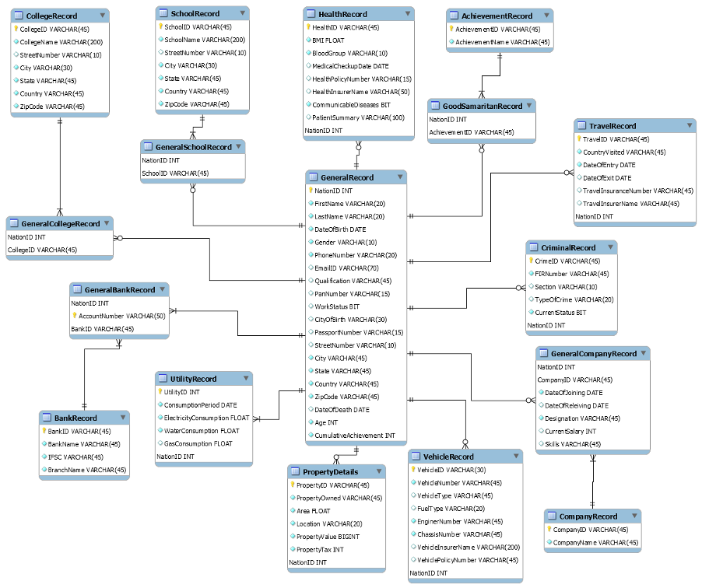
ER Diagram

Slide 5
ER Diagram

Slide 6
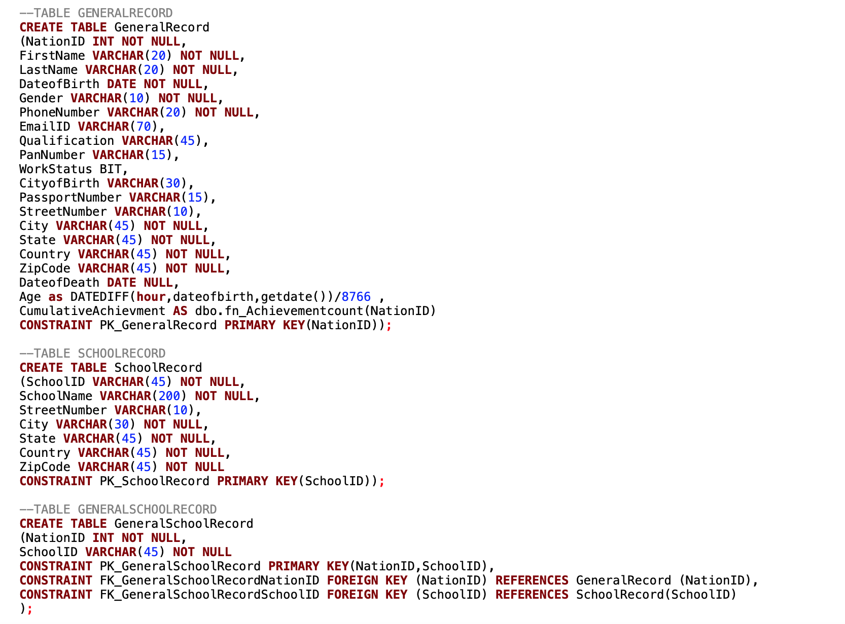
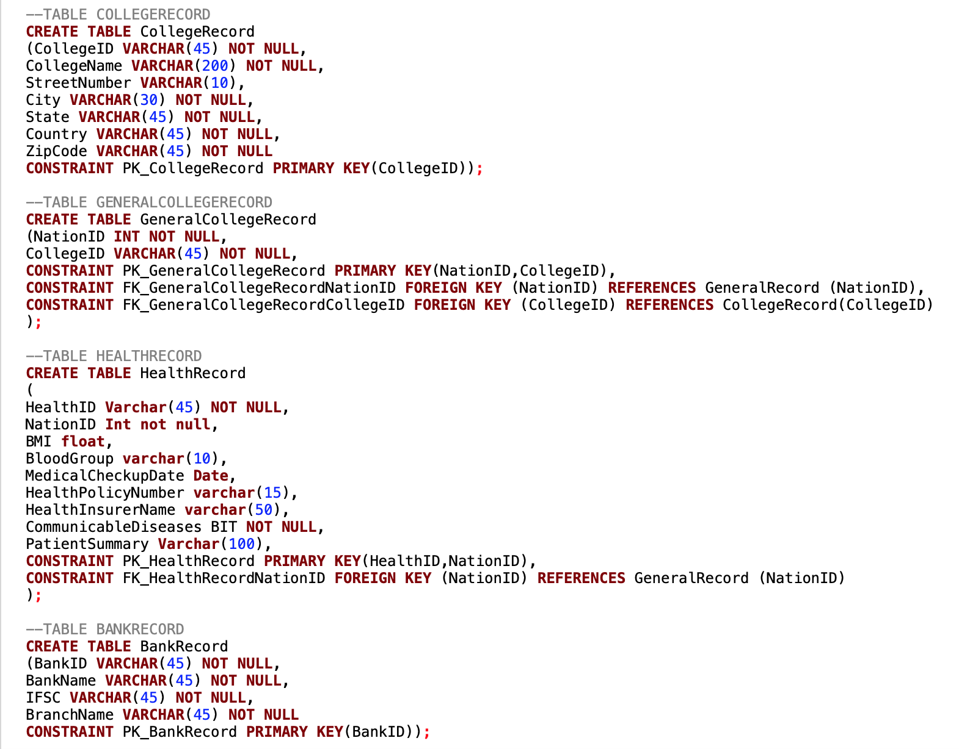
Database Implementation-DDL Commands

Slide 7
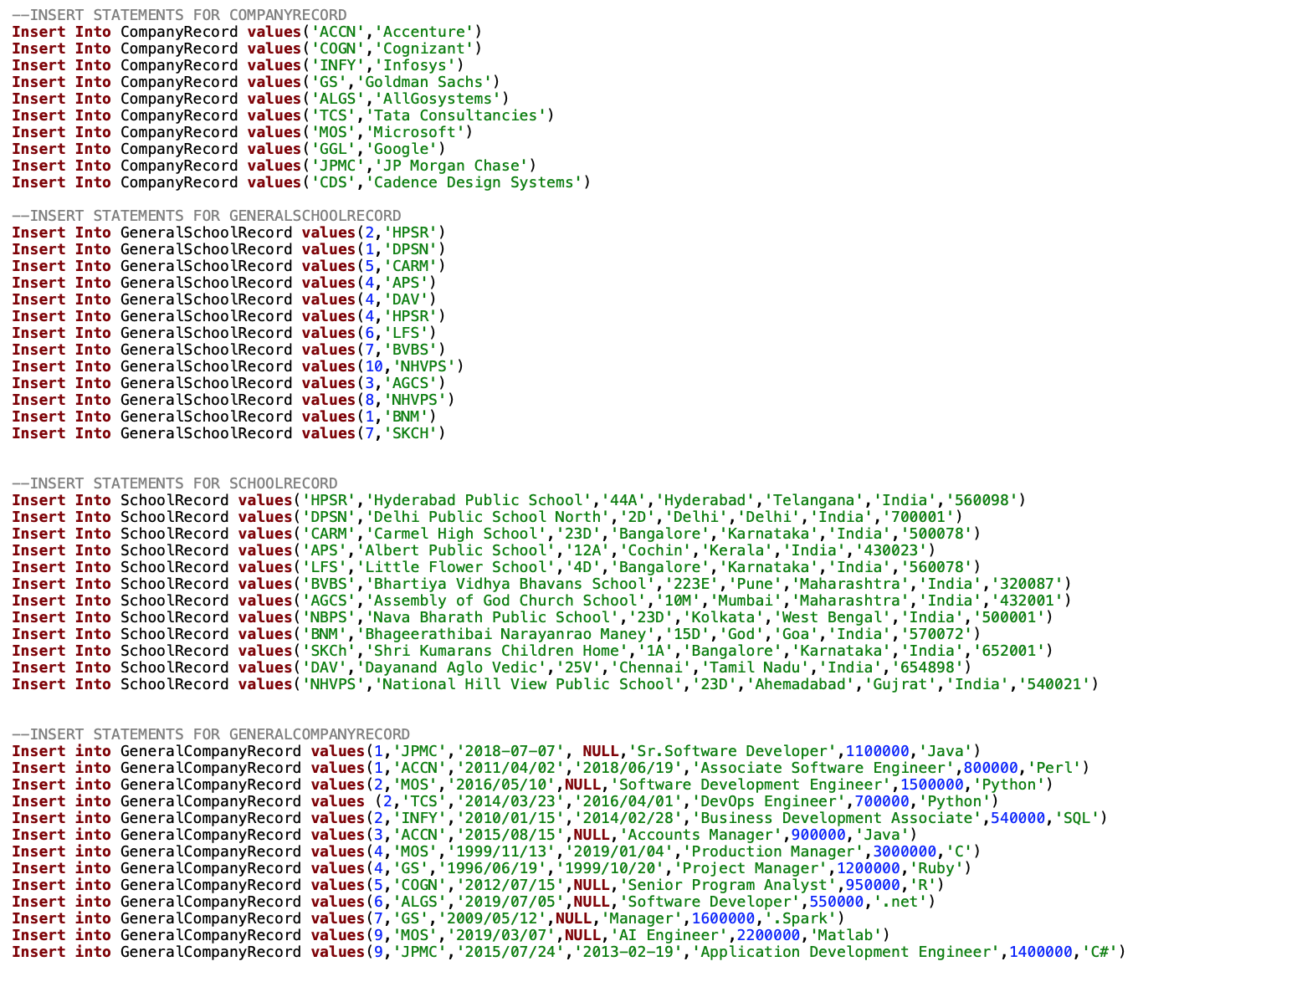
Database Implementation – DML Commands

Slide 8
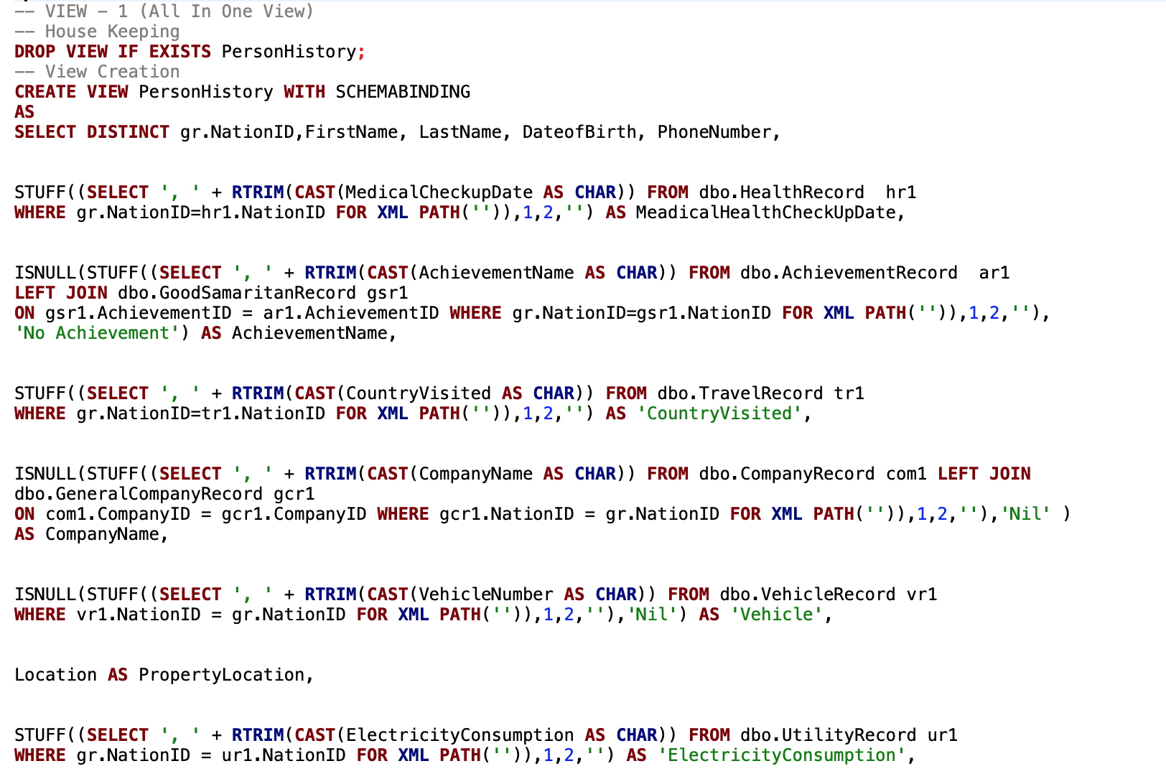
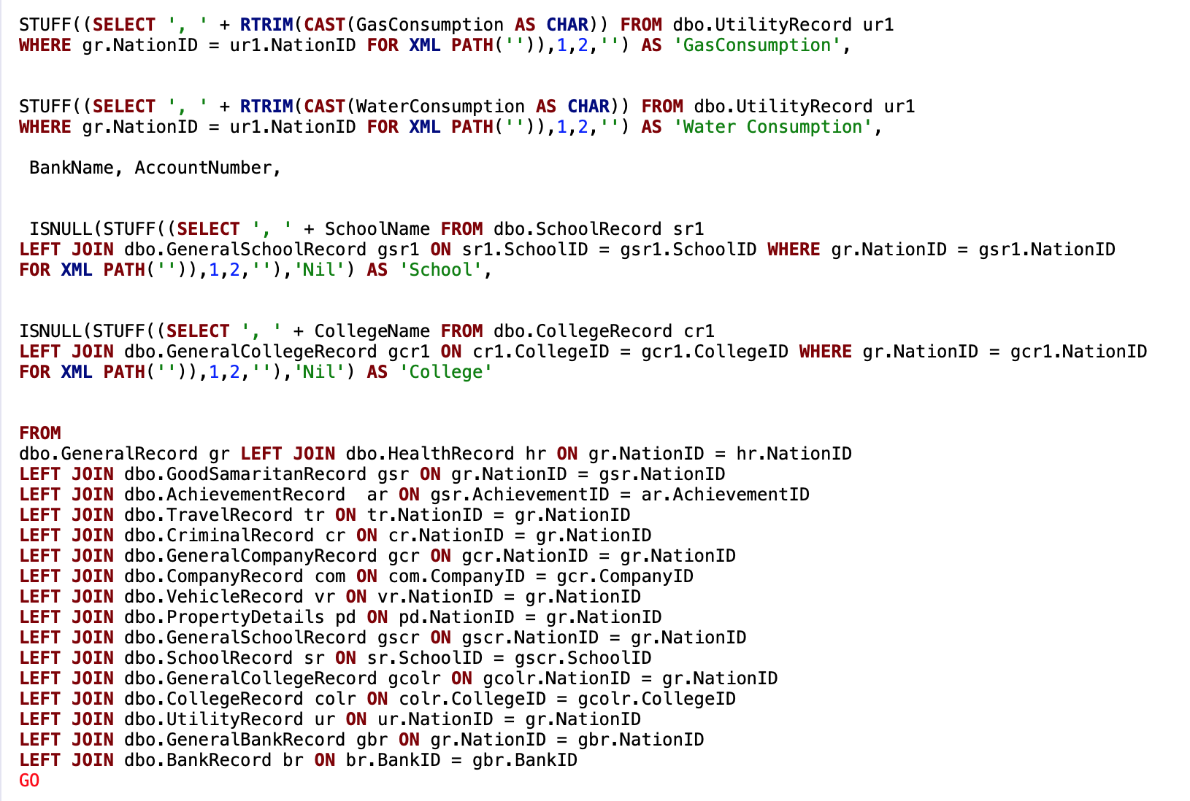
View – Person History

Slide 9
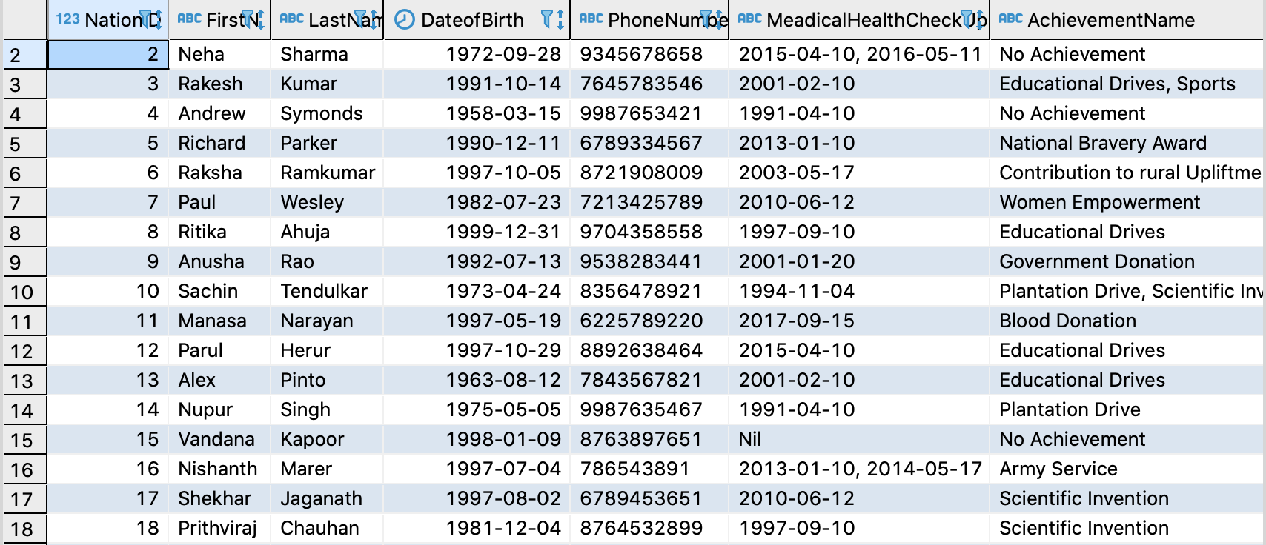
Result

Slide 10
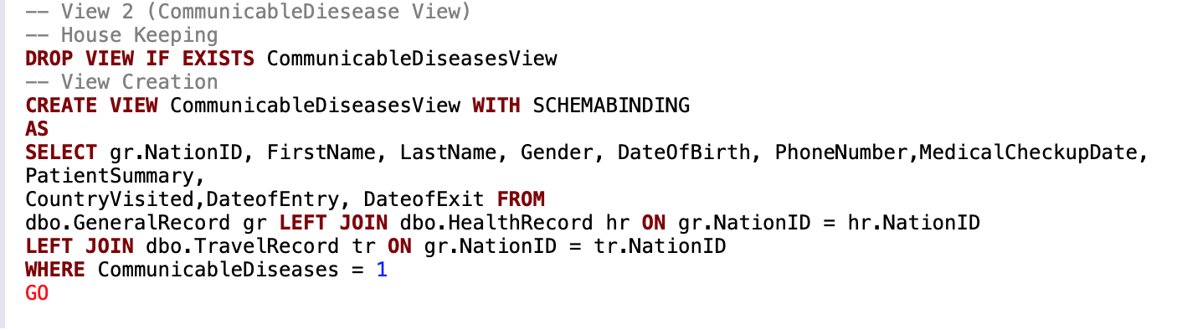
View – Communicable Disease

Slide 11
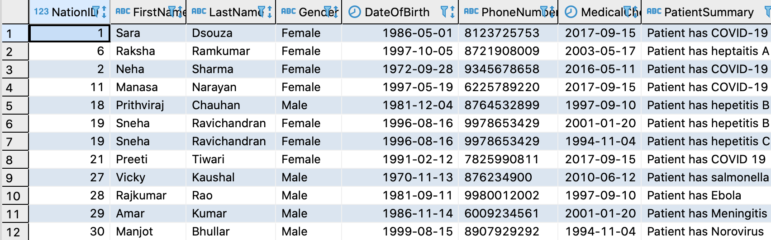
View - Result

Slide 12
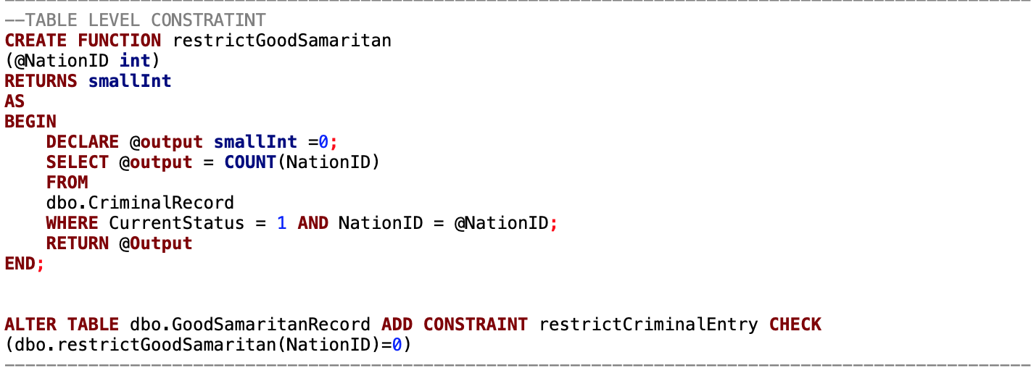
Table Level Constraint
Restricts NationIDs with Criminal Records to be entered in Good Samaritan Record

Slide 13
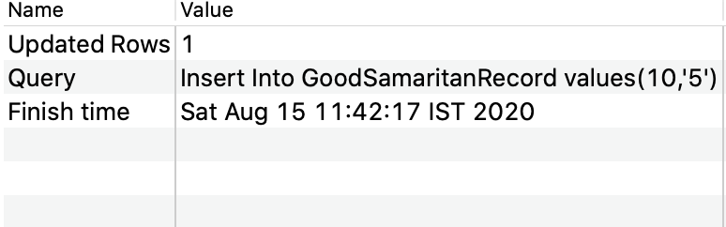

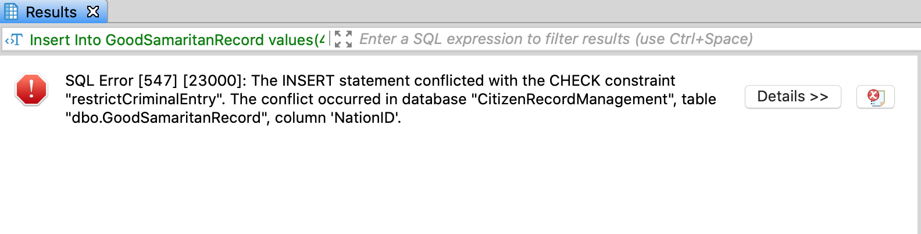

Table Level Constraint - Result

Slide 14
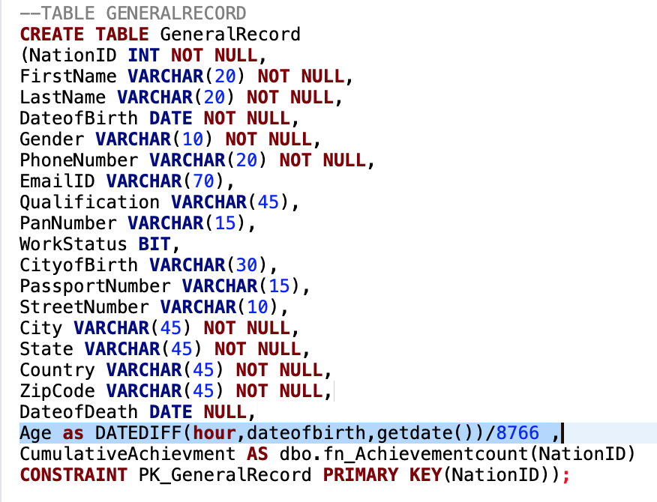
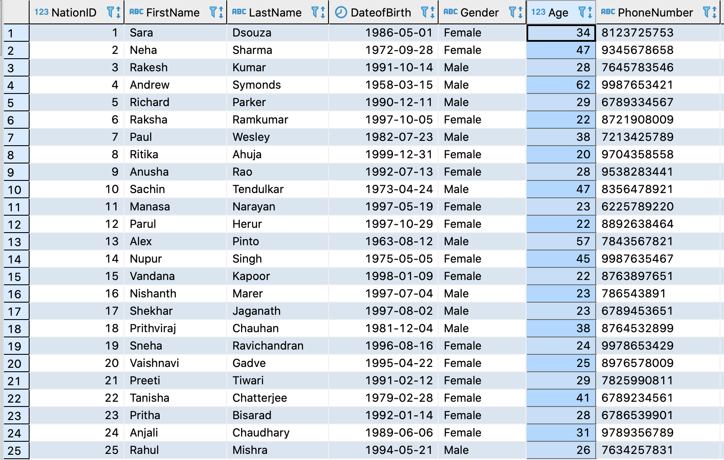
Computed Column – Age Calculation

Slide 15
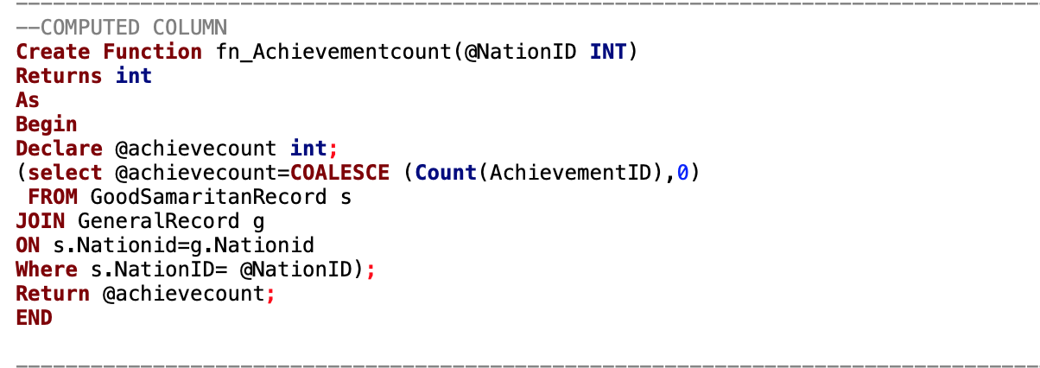
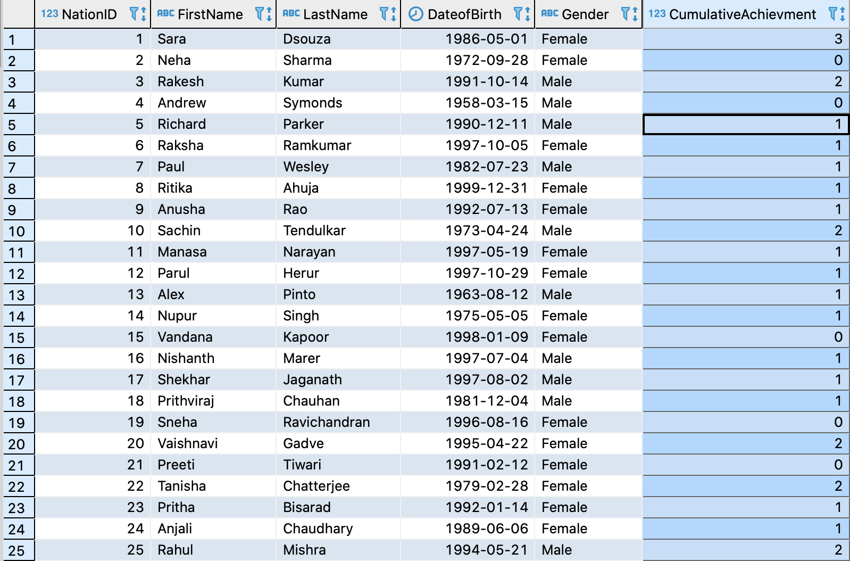
Computed Column – Calculation of cumulative achievement

Slide 16
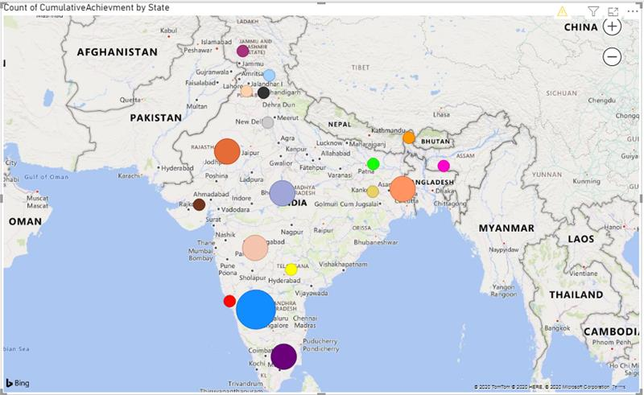
Data Visualisation Count of Cumulative Achievement by each state

Slide 17
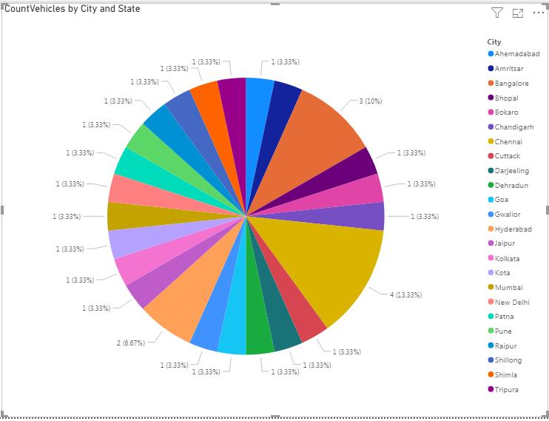
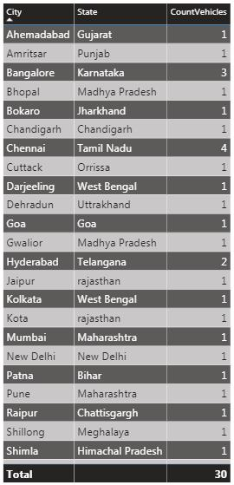
Number of vehicles by city and state

Slide 18
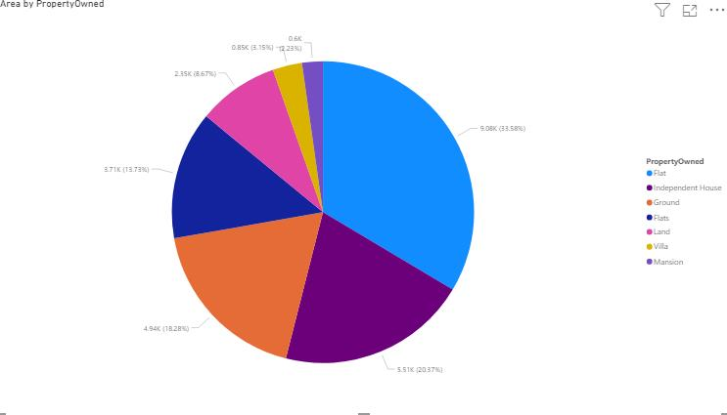
Types of property

Slide 19
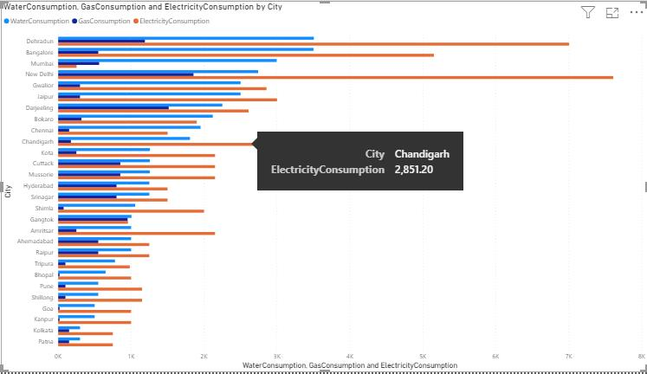
Utility Consumption by each City

Slide 20


